Slide 1

OLA Ride Insight

Slide 2
Project Overview
This project is an end-to-end OLA Ride Analytics Platform built using SQL, Power BI, Python, and Streamlit.
The project analyzes ride booking data to generate business insights related to:
Ride performance
Customer behavior
Vehicle performance
Revenue analysis
Cancellation patterns
Driver and customer ratings

Slide 3
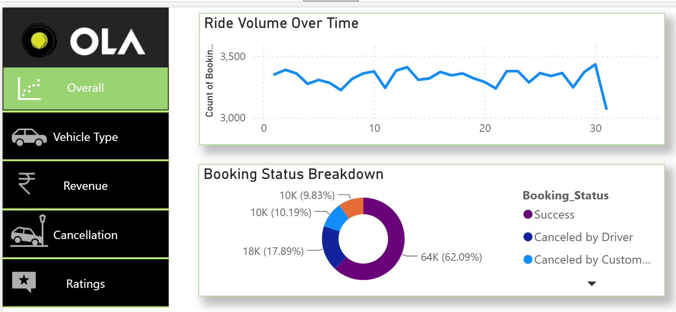

Slide 4
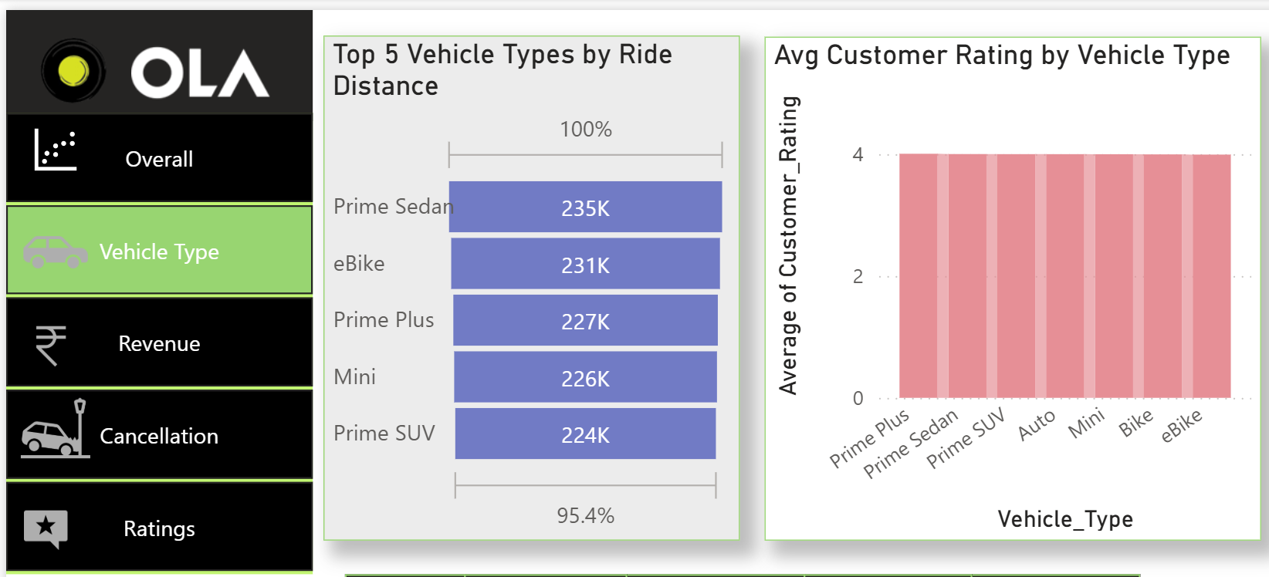

Slide 5
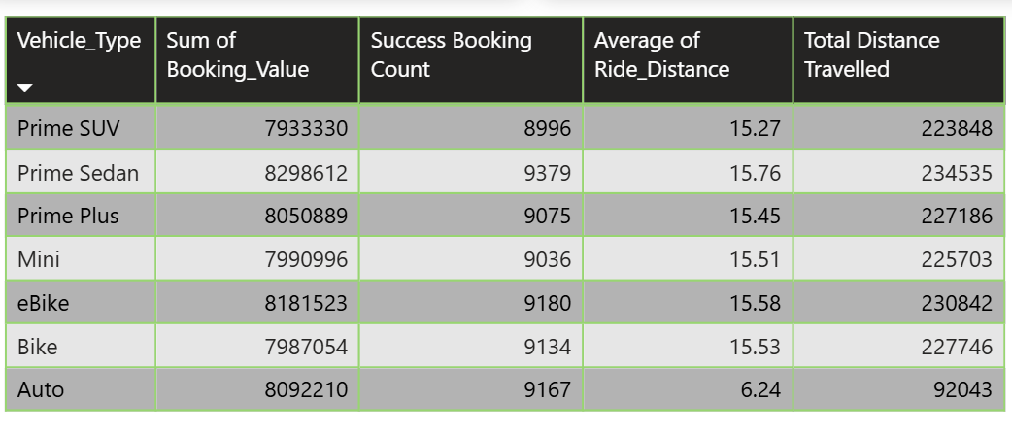

Slide 6
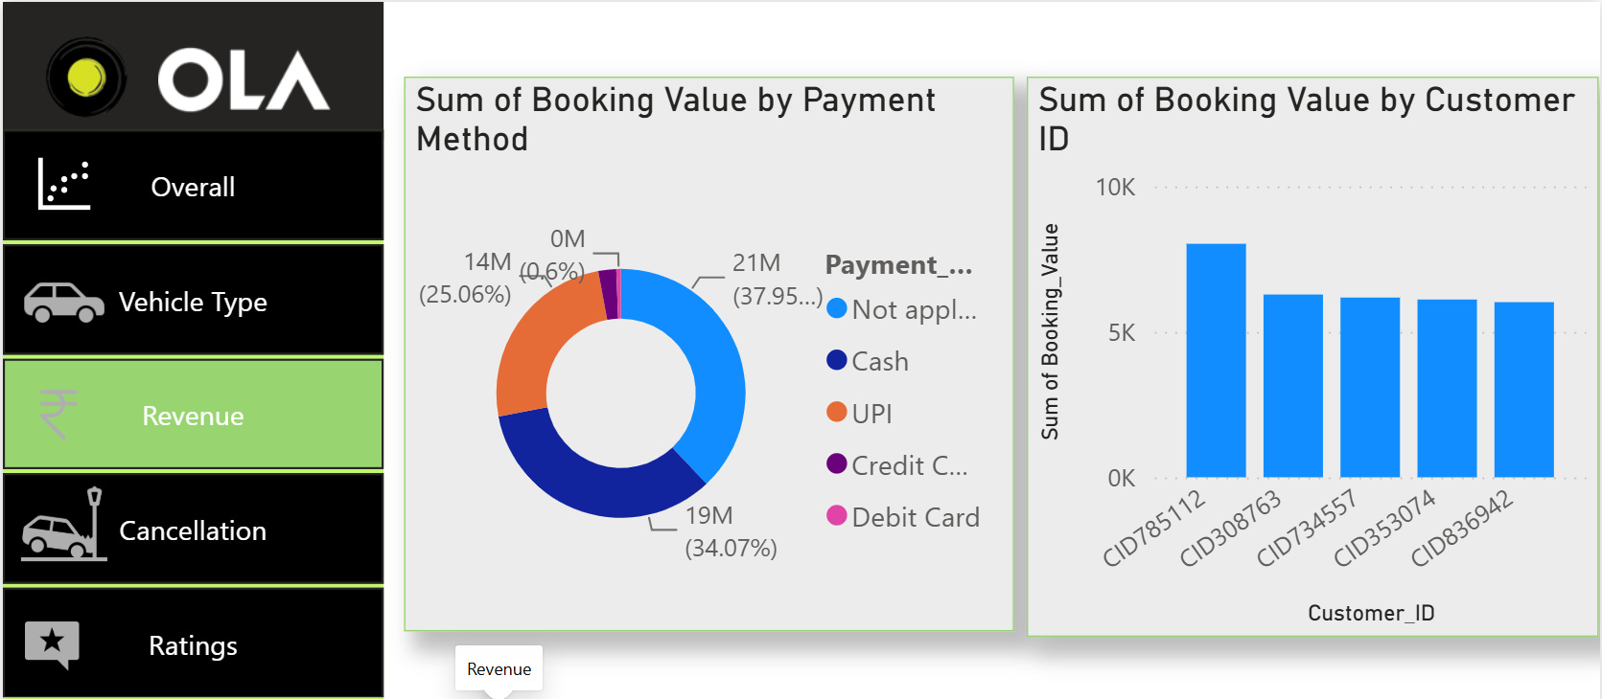

Slide 7
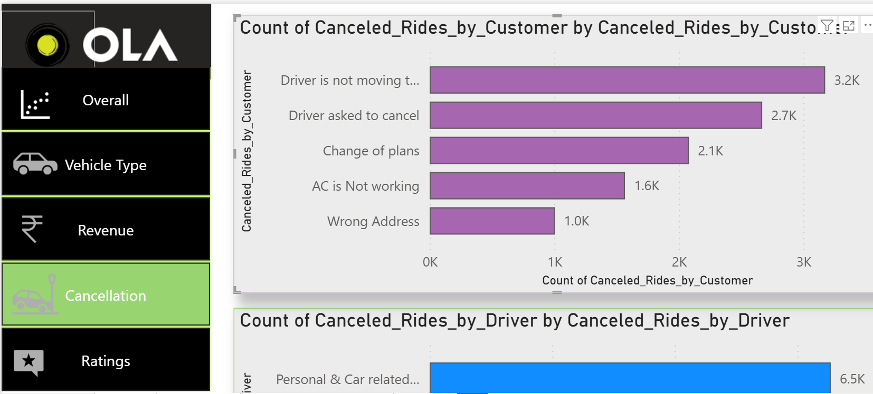

Slide 8
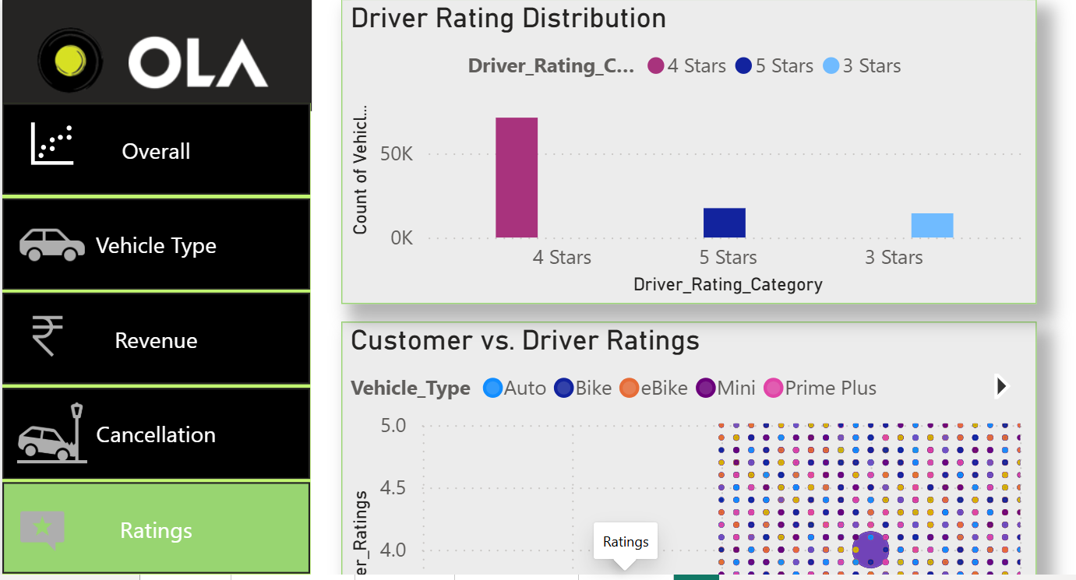

Slide 9
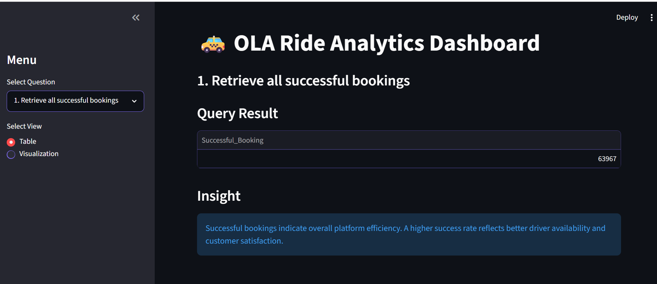

Slide 10
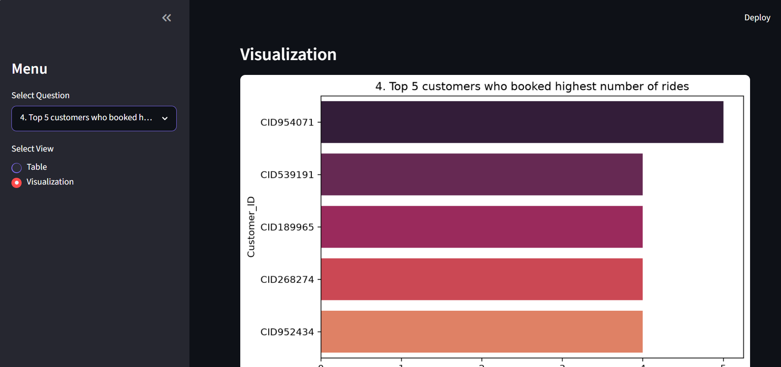

Slide 11
Project Outcome
This project demonstrates:
✅ Data extraction and analysis using SQL
✅ Database connectivity using Python
✅ Interactive analytics using Streamlit
✅ Business dashboard creation using Power BI
✅ KPI creation using DAX
✅ Customer, revenue, and operational insights generation

Slide 12
Thank You

